Slide 1
Vagrant Up! Comprehensive development System Automation

Slide 2

What is Vagrant?
Manages VM software (VirtualBox, VMware, AWS, etc.)
Automates VM creation
Provisioning
Notes:
(CLICK) Vagrant is built for managing VM environments on any provider
(CLICK) Vagrant Focuses on automation which is going help to speed up your development setup time
(CLICK) Vagrant orchestrates Provisioning. This is going to allow you to automate processes such as software installations, changes to configuration files, and update virtual machines

Slide 3


Why Vagrant?
Easy to use
$ vagrant up
Easy to manage
Wide variety of platforms
Subnet: 192.168.5.1/24
Subnet: 192.168.10.1/24
vagrant reload
Vagrantfile
Notes:
(CLICK) Vagrant is easy to use all it takes is one command!
(CLICK) Vagrant makes managing virtual machines easy. (CLICK) So, say we created 5 VM’s and configured them to communicate with each other with static IP addresses on the following subnet. If the IP addresses for all 5 boxes needed to change, rather than having to configure each one manually in VirtualBox, (CLICK) we could just edit our Vagrantfile, (CLICK) and run vagrant reload and we’d be good to go!!!
(CLICK) There are numerous amounts of predefined boxes that will allow you test many different operating systems. All you need to do is specify the predefined box inside the Vagrantfile!!!

Slide 4
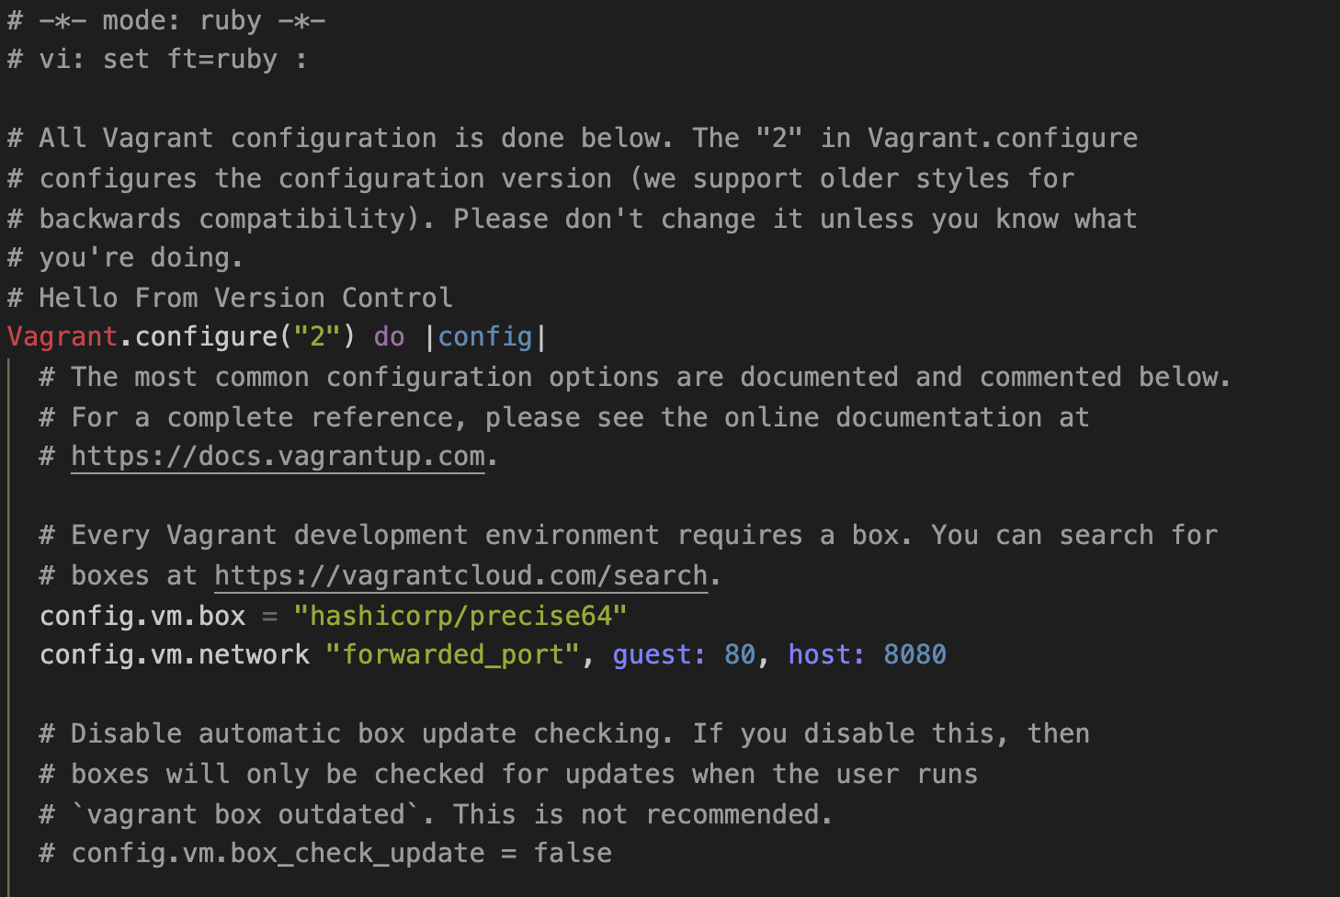
What is a Vagrantfile?
Configuration
Ruby Programming Language
Notes:
(CLICK) Vagrantfiles are used to specify which type of machine or operating system you want to use for a project
(CLICK) Vagrantfiles are written in Ruby, although prior experience with Ruby is not necessary to configure your Vagrantfile.
Now I am going to go over a basic demonstration using vagrant. For this demo, I created a Linux box with Apache and PHP, but its currently in the “saved” state. I’m going to go over the project’s Vagrantfile as well as the provisioning script I created help automate the setup of the virtual machine

